Slide 1

Bootstrap:Reactive
Notes:
You were hand picked to be here. BS veterans who want to go deeper, or experienced CS teachers who want to learn pedagogy for Bootstrap. You each have something to offer everyone else, you all bring something unique to the table.
BS teachers - most of you are math teachers, who've mastered the BS pedagogy. You're here to learn content.
CS teachers - you know the content. you're here to learn pedagogy and a completely different approach to programming. If you’ve never done functional programming before, this is a completely new approach.
If you've seen BS:A, you know just how high a bar we set for ourselves in terms of polish. This isn't quite there yet - we have a strong foundation, and we’re excited to share it with you.

Slide 2
Bridging to CS
K-12
Looooong bridge
Algebra still key
College/AP/Industry
C-like syntax
Programming, not hacking
Notes:
Building a Bridge
We can imagine the spectrum of computer science education as a bridge. The goal of many K-12 CS courses is to get kids to reach this right side of the bridge- maybe/for some that’s AP CS in high school, taking CS classes in college, or going to work for a major tech company. For all of us, the right side of the bridge means more rigorous CS.
This side tends to use languages like Java, C, maybe Python.
Last 20 years, big cultural shift- it used to be at major tech companies, (MS, IBM, etc.) programmers were judged based on how many lines of code they wrote or the number of bugs fixed, and fixing them quickly was important.
For any of you in audience who have rushed through code and then spent 10x as much time debugging than it would have taken to solve problem in first place, you know this isn’t sustainable. And this is what tech companies grew to learn.
If you walk into your Google interview and say you know Java, they won’t care. It’s not enough to write code, your interviewer wants to see that you can write software. And that means skills that aren’t just about coding:
Writing unit tests
type specifications
documentation
20 years ago, on the left side of the bridge….
So now kids are on this bridge and saying I love Scratch, I’ve gone through hour of code, what's next?
Now we face 2 problems: 1) It’s a long way across this bridge between dragging blocks in Scratch and doing more rigorous programming in Java.
2) Maybe we’ve solved CS engagement issue, but if kids are still failing math they’re not graduating HS, and if they’re weak on important algebraic concepts like functions, in most schools they’re not able to enroll in AP chemistry, Physics, OR AP CS.

Slide 3
Bridging to CS
K-12
Engaged students
Bootstrap:1
“What’s next?”
College/AP/Industry
C-like syntax
Programming, not hacking
Notes:
In BS1, we took engaged kids and taught them Racket, rigorous software engineering habits in an algebra class.
First PD workshop in 2011 Houston, TX
Thanks to teachers like you we’ve grown and now serve 15k students, fortunate to continue our research
Great results- we can show transfer from algebraic programming to an increase in algebra performance
As students cross the bridge they have to change syntax, semantics (objects don’t work the same in one language as another) they have to change tools (if you’ve switched from Visual Studio to Eclipse knows there’s a learning curve), and we have to change curriculum (a problem solving approach in one class might be totally different than the approach taught in another)
Each of these cause friction, and if you’re a really motivated kid that already wants to be a computer engineer, you’ll be able to handle it. But who do you think are the kids hurt most, and most likely to fall off the bridge?
Not just a research issue, it’s an equity issue.
We’re all realizing that one way or another we have to cross all four of these hurdles. And everyone is thinking about this: how do we go from Scratch to Python?
At Bootstrap, we built the software, the curriculum, and the pedagogy ourselves to make these transitions easier. And now, for Bootstrap:2, we’ve identified a language that allows you to confront only two of these friction points, to make these transitions across the bridge easier for teachers and students. And I’ll introduce one of the creators of that language now!

Slide 4


It’s about more than the language
Low Floor Circles of Evaluation Algebraic behavior Great pedagogy
Low ceiling “Weird” syntax Limited bridge to other languages
High Ceiling Mainstream syntax Popular
High Floor Not algebraic! Limited bridge from other languages
High Ceiling
Mainstream syntax
Algebraic behavior
Great pedagogy
New Syntax
Notes:
Joe does this slide?
Python is the 4th most popular language in the world!
This is our solution to the issue of scale
In BS:2 we switch languages, but we have the tool, techniques, pedagogy, stay the same. All that changes is syntax.
Pyret functional version of Python- it’s Python that’s algebraic

Slide 5
Goals for this workshop
Introduce you to Pyret
Demonstrate Bootstrap:Algebra pedagogy applied to higher level computer science
Build sophisticated programs
Talk to other teachers
Get your feedback
Notes:
We’re out to get the foundations right. Everything else is just elbow grease.
We want your feedback! Especially on-
Your adjustments to the new syntax, and the tool itself! One of the lead developers is here!

Slide 6
Unit 1
Notes:
Two tabs: CPO, bootstrapworld BS:R

Slide 7
Everything you learned in BS:A
code.pyret.org
Bootstrap:Reactive Teacher Materials
Open the Review file
Introducing CPO…
Infix notation
Image module
Notes:
PAPER FIRST!!!
Workbook pg.1
Then CPO
One of the first things you’ll notice is the phrase “include image” at the top of the screen. Pyret has even more functions than we used in racket for Bootstrap:1, so to keep things simple, we’ve grouped some of these functions into modules. The line include image tells Pyret to load all of the functions from the image module so we can use familiar functions like star, triangle, rectangle, put-image, etc..
OUTLINE- why did we intentionally choose a bad name?
Pedagogy- names are just names. They don’t mean anything to the computer. Nothing about the name outline or square that will tell you what kind of an image it would be.
You’ll also notice we can write (4 + 5). (But with spaces!!!!) we’ve also made a compromise, because now we mandate parentheses for multiple functions.

Slide 8
Contracts
<name> : <domain> → <range>
# num-sqrt : Number → Number
# num-sqr : Number → Number
# + : Number, Number → Number
# - : Number, Number → Number
# * : Number, Number → Number
Notes:
num-sqrt: in Pyret, many of the function names force students to be conscious of what inputs they’re taking in

Slide 9
Contracts
circle(75, “solid”, “red”)
rectangle(20, 30, “outline”, “pink”)
ellipse(85, 100, “solid”, “green”)
text(“Hello world!”, 50, “blue”)

Slide 10
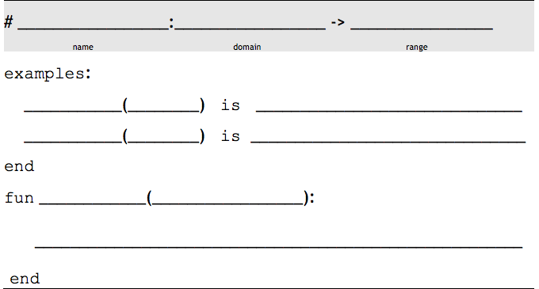
The Design Recipe
triple
Number
Number
n
triple
6
6 * 3
triple
13
13 * 3
triple
n
n * 3

Slide 11
The Design Recipe
gt
Number
Image
size
gt
7
triangle(7, “solid”, “green”)
gt
22
triangle(22, “solid”, “green”)
gt
size
triangle(size, “solid”, “green”)
Notes:
Closing: you’ve gotten familiar with Pyret syntax, for those familiar with BS1, the design recipe still works, and for those of you who weren’t, you’ll get very familiar with DR soon.

Slide 12
Images in Pyret
# put-image : Image, Number, Number, Image -> Image
# image-width : Image -> Number
# image-height : Image -> Number
# flip-horizontal : Image -> Image
# flip-vertical : Image -> Image
# scale : Number, Image -> Image
# rotate : Number, Image -> Image

Slide 13
Unit 2

Slide 14
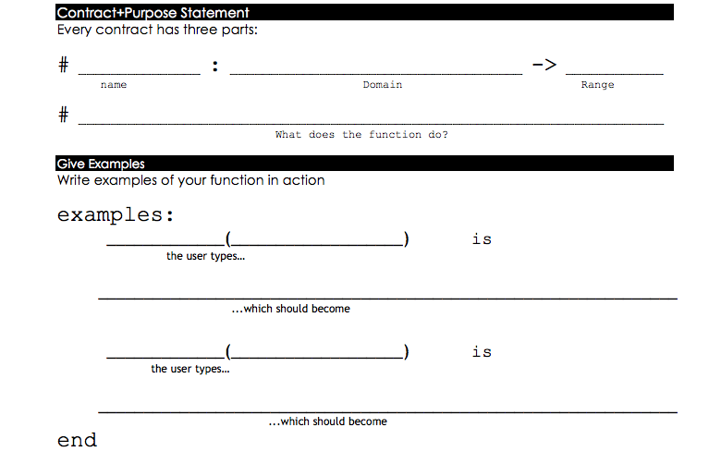
double-radius
Number, String
Image
Consumes a radius and color, produces an outlined circle of the given color whose radius is twice the given number
color
double-radius
30, “red”
radius
circle( 30 * 2, “outline”, “red”)
double-radius
7, “purple”
circle( 7 * 2, “outline”, “purple”)

Slide 15
Parachute Jumper
What data type should my range be?
Number? String? Image? Boolean?
Introducing JumperState…
# jumper : Number, Number → JumperState
JumperStates are just another value…
Notes:
4 data types you already know about, can you use them to return two things? Is a number good for this? String? Image? None of these things will work for this task, but we have a way of combining things: structures. BS1 teachers, this is an upgrade to our language- new concept that we didn’t see in BS1- NEW STUFF!!!
try making some JumperStates, see what happens, THEN talk about capitalization

Slide 16
next-position
Number, Number
JumperState
Consumes an x and y, produce a JumperState with x + 5 and y - 5
y
next-position
33, 70
x
jumper(33 + 5, 70 – 5)
next-position
8, 20
jumper(8 + 5, 20 – 5)

Slide 17
Your Bakery
Flavor
Number of layers
Whether or not the cake is an ice cream cake
Notes:
What data type would you use to represent each of these aspects of a Cake?

Slide 18
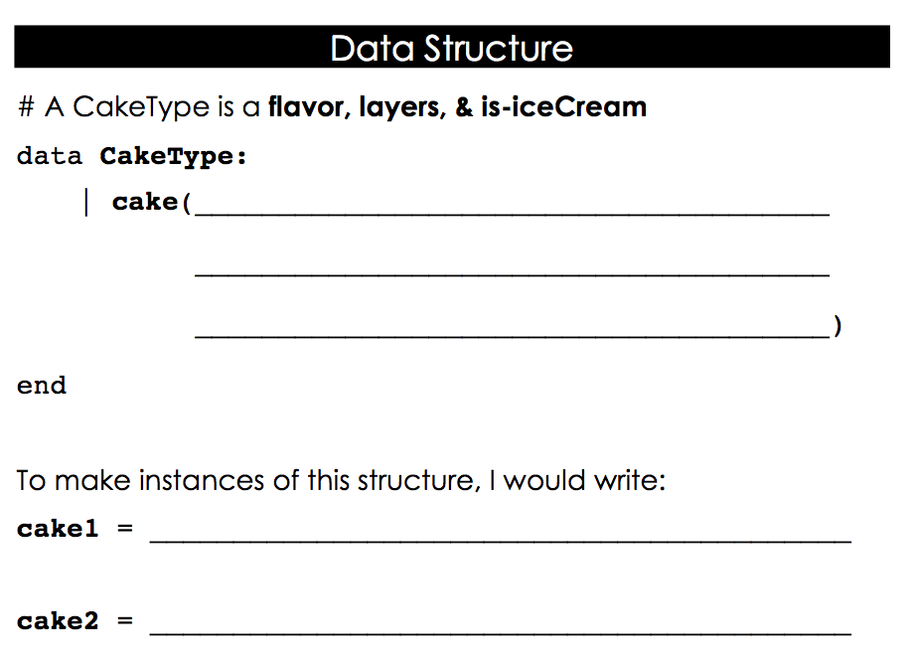
flavor :: String,
layers :: Number,
is-iceCream :: Boolean
cake(“vanilla”, 4, true)
cake(“chocolate”, 8, false)
Notes:
NEW SYNTAX!!!
Data block, listing the name of the field and the type of the field, separated by two colons

Slide 19
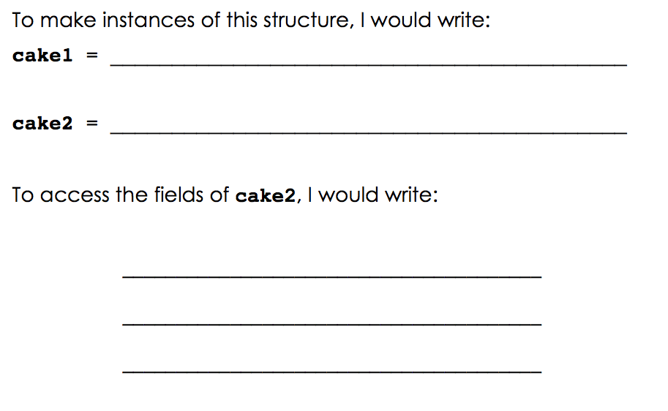
cake(“vanilla”, 4, true)
cake(“chocolate”, 8, false)
cake2.flavor
cake2.layers
cake2.is-iceCream

Slide 20
taller-than
CakeType, CakeType
Boolean
Consumes two CakeTypes and asks if the number of layers in the first CakeType is greater than the second
a-cake2
taller-than
birthday-cake, pb-cake
a-cake1
birthday-cake.layers > pb-cake.layers
taller-than
wedding-cake, strawberry-cake
wedding-cake.layers > strawberry-cake.layers

Slide 21
will-melt
CakeType, Number
Boolean
Consumes a CakeType and temp, asks if the temp is greater than 32 degrees AND if the Cake is an ice cream cake
temp
will-melt
cake1, 75
a-cake
(75 > 32) and cake1.is-iceCream
will-melt
cake2, 29
(29 > 32) and cake2.is-iceCream
Notes:
‘and’ should be written infix

Slide 22
Unit 3

Slide 23


Animating a Sunset

Slide 24
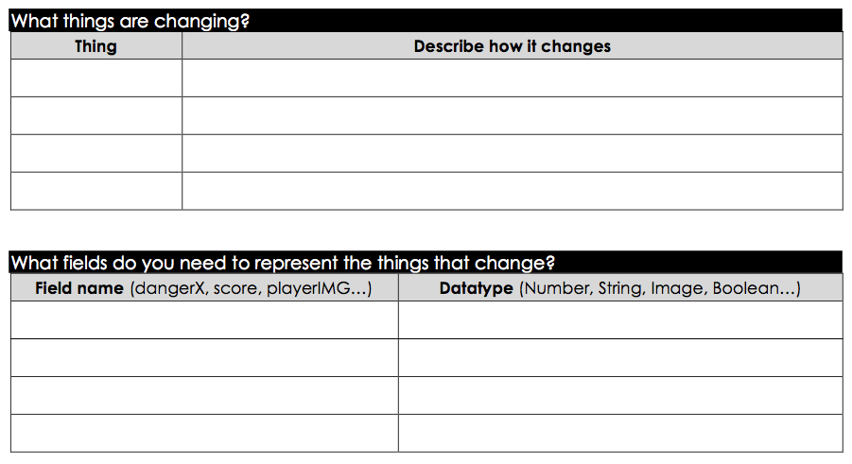
Sun’s x-coord
Increases as sun moves across the sky
Sun’s y-coord
Decreases as sun falls in the sky
x
Number
y
Number

Slide 25
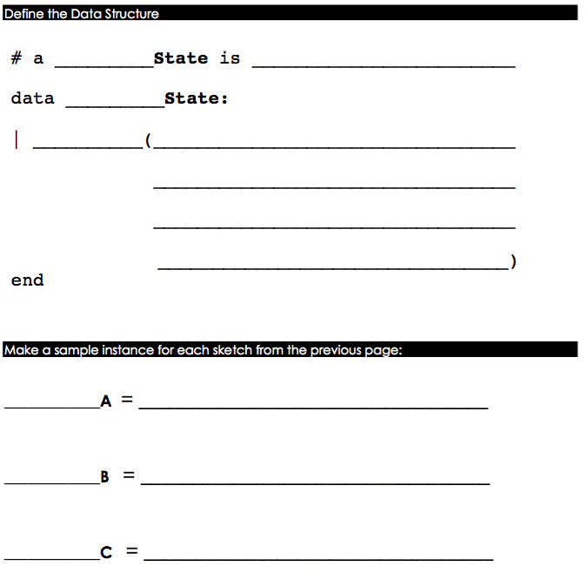
Sunset
the x and y-coordinate of the sun
Sunset
sunset
x :: Number,
y :: Number
TOP-LEFT
sunset(10, 300)
MIDDLE
sunset(200, 150)
BOTTOM-RIGHT
sunset(275, 75)

Slide 26
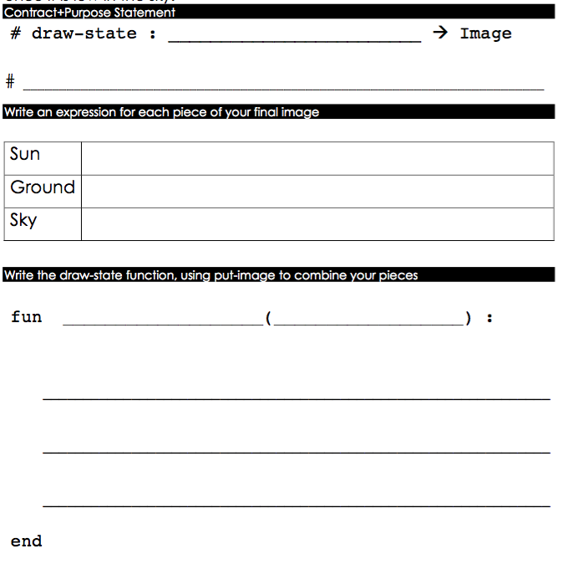
SunsetState
Draw the image of a yellow sun at its x and y-coordinates on the scene
circle(25, ”solid”, “yellow”)
rectangle(WIDTH, HEIGHT, “solid”, “light-blue”)
rectangle(WIDTH, HORIZON-HEIGHT, “solid”, “brown”)
draw-state
a-sunset
put-image(rectangle(WIDTH, HORIZON-HEIGHT, “solid”, “brown”),
200, 50, put-image(circle(25, “solid”, “yellow”),
a-sunset.x, a-sunset.y, rectangle(WIDTH, HEIGHT, “solid”, “light-blue”)))

Slide 27
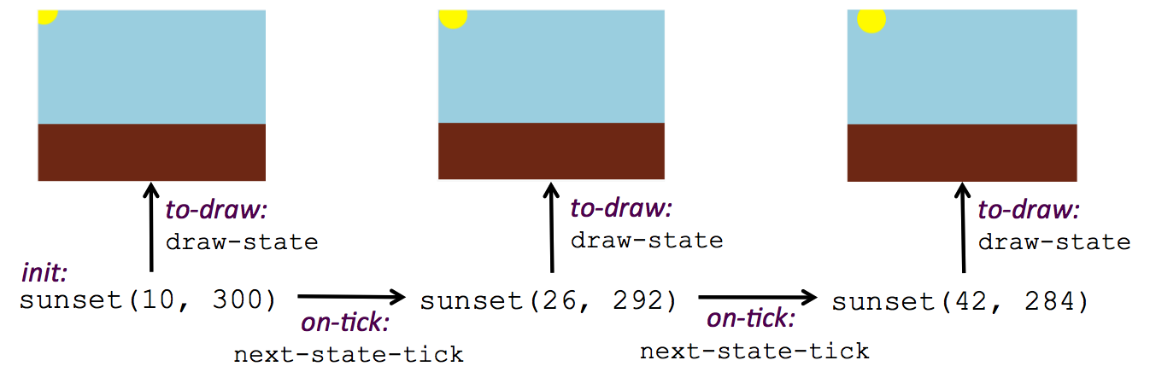
The Reactor

Slide 28
4 steps to an animation
Define the state to hold the information that changes across frames.
Write a function to generate an image of the current state (draw-state).
Write a function to generate a new state from a given state (next-state-tick).
Define a reactor using an initial instance of the state and the two functions to create an animation.

Slide 29
Acting out a Reactor
The reactor: “directs the action”
draw-state: draws the image of the given state
next-state-tick: on each clock tick, computes the next state

Slide 30
From Animations to Structures
Sample animations from Reactive teacher resources page
Workbooks- pg.19

Slide 31
Brainstorm
Imagine that you have a data structure consisting of just a single number.
Brainstorm what animations you could create with this data. What could that number represent?

Slide 32
Brainstorm
Imagine that you have a data structure consisting of just two numbers.
Brainstorm what animations you could create with this data. What could those numbers represent?

Slide 33
Unit 4

Slide 34
What to Wear?
What does wear(50) evaluate to?
What does wear(100) evaluate to?
What is the domain and range of the wear function?
What is the name of the variable in the wear function?
Change the wear function to return the shorts outfit when it’s cold (less than 30 degrees).
Challenge: Change the wear function to use Celsius degrees rather than Fahrenheit.

Slide 35
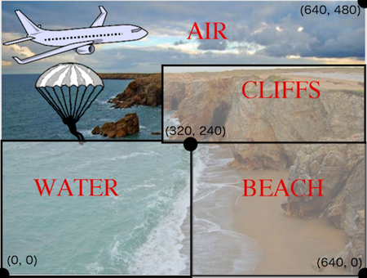
Where’s the Jumper?
Notes:
Workbook pg. 28- location function

Slide 36
Colorful Sun
Workbook pg. 33: draw-sun
Extensions:
Make the sun reset at the top of the screen when it falls below the horizon
Change the color of the sky as the sun sets
Share back different ways you could change the color of the sun/sky

Slide 37
Unit 5

Slide 38
Keypresses & the Reactor
Acting out:
The reactor: “directs the action”
draw-state: draws the image of the given state
next-state-key: on each keypress, computes the next state

Slide 39
Moving Character
Extensions:
Change the character to one of your choosing, and add a background
Add boundaries so your character stays within the scene
Use the num-to-string function to display the coordinates at the top of the screen
# num-to-string : Number -> String

Slide 40
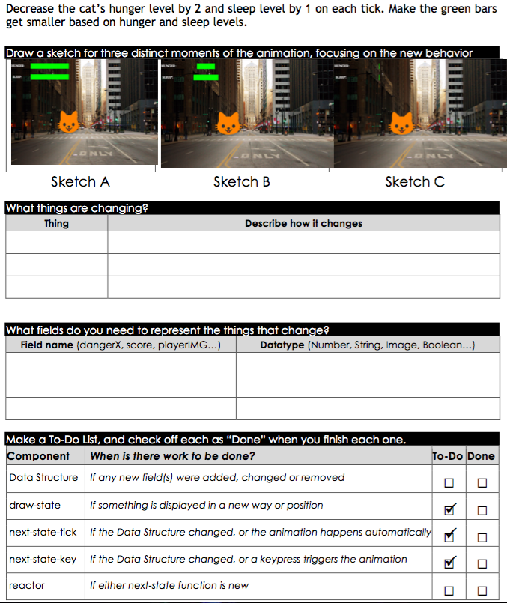
Hunger level
Decreases on each clock tick
Sleep level
Decreases on each clock tick
------

Slide 41
Your Virtual Pet
Workbook pg. 38: Use the Animation Extension worksheet to make cat’s hunger increase by 10 when “f” key is presses, and sleep increase by 5 when “s” key pressed.
Workbook pg. 40: Use the Animation Extension worksheet to change the image of the pet when the game is lost

Slide 42
Your Virtual Pet
Extensions:
Find your own images to create a different virtual pet
Stop the bars from overflowing some maximum.
Add an x-coordinate to the PetState so the pet moves around, either on keypress or automatically.
Add a costume to the PetState, then change the draw-pet function so that it changes the costume based on the pet’s mood (if a-pet.hunger <= 50, show a pic of the pet looking hungry)

Slide 43
Personal Projects
Create an animation or game from scratch!
Workbook pg. 43: Animation Design Worksheet
Bootstrap:Reactive Features:
Collisions
Scores
Levels
Nested Structures
Writing Pong

Slide 44
Implementation

Slide 45


Connect with Us!
/ BootstrapWorld
@BootstrapWorld
Questions:
bit.ly/BootstrapHelp
Grab a photo!

Slide 46

Notes:
Use this slide as background for the Group Photo

